Slide 1





Beyond Likes: A Comprehensive Analysis of Social Media's Influence on Students
Date: December 23, 2023
Under the Guidance of: Dr. Rashmi Awad
Prepared by: Nishant Deshmukh

Slide 2
Introduction
Problem and Motivation
Purpose of Study and Research Question
Data Analysis and Visualization
Statistical Analysis
Limitations
Conclusion
Overview

Slide 3



Introduction
Social media is a term for websites and apps that allow people to communicate, create communities, and share content. It's a digital technology that allows users to share ideas and information through virtual networks and communities. Social media revolutionized communication, connecting people globally through platforms like Facebook, Twitter, and Instagram. Emerging in the early 21st century, it became a powerful tool for sharing ideas, fostering community, and shaping public discourse. Social media's impact on society, culture, and politics continues to evolve, influencing the way we connect and share information.

Slide 4

Problem and Motivation
The Impact of Social Media on Students' Academic Performance
As students today are surrounded by digital technology and social media, it can become a hindrance to their academic success. The constant connectivity poses a challenge, leading to distractions that can impact focus and study habits.
This presentation is designed to explore the relationship between social media engagement and academic achievement. By examining both the positive and negative aspects, aim to equip educators, parents, and students with data-driven insights. Through a comprehensive analysis, hope to discover solutions to overcome difficulties and leverage the positive aspects of social media to create a more constructive and supportive learning environment.

Slide 5
Purpose of Study and Research Question
The primary objective of this presentation is to illuminate the statistical impact of social media on students' lives and the research question guiding this study is, "Does social media have a distinctive impact on students' academic lives?" To delve deeper into this inquiry, the following questions are considered:
1. How do students utilize social media?
2. To what extent does social media support students' learning?
3. What is the perceived impact of social media on students' academic lives? 4. How does students' social media usage relate to their sleep patterns, and what impact does this connection have on their academic experiences in higher education?

Slide 6
Data Collection: An online survey was conducted by distributing a Google Form link across various social media platforms. A total of 118 responses were gathered through the Google Form, providing valuable data for analysis and insights.
The variables of social media that may affect the students’ academic performance are:
Demographic
Academic Performance
Social Media Platform
Time Spend Study
Sleep and Sleeping Pattern
Impact of Social Media on Student’s Academic Performance
Level and Year of Study
Time Spend on Social Media
Device for Access
Perception
Purpose of Using Social Media

Slide 7
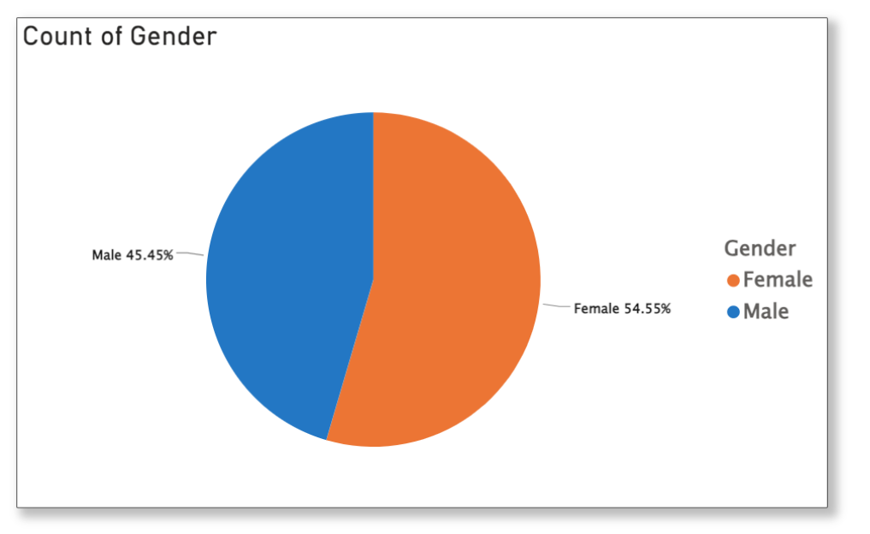
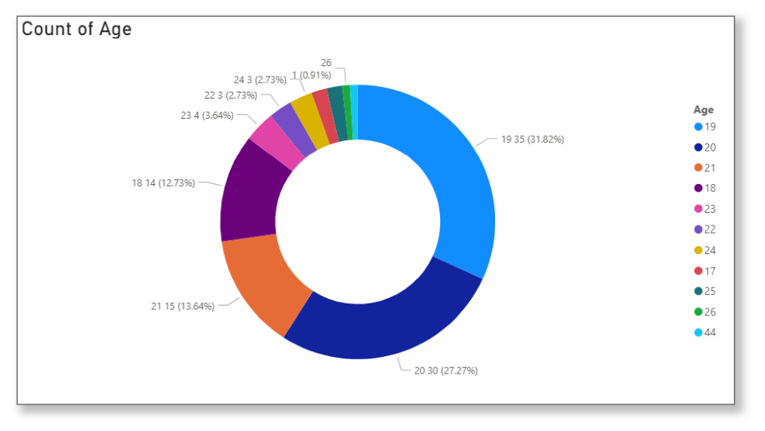
Data Analysis and Visualization

Slide 8
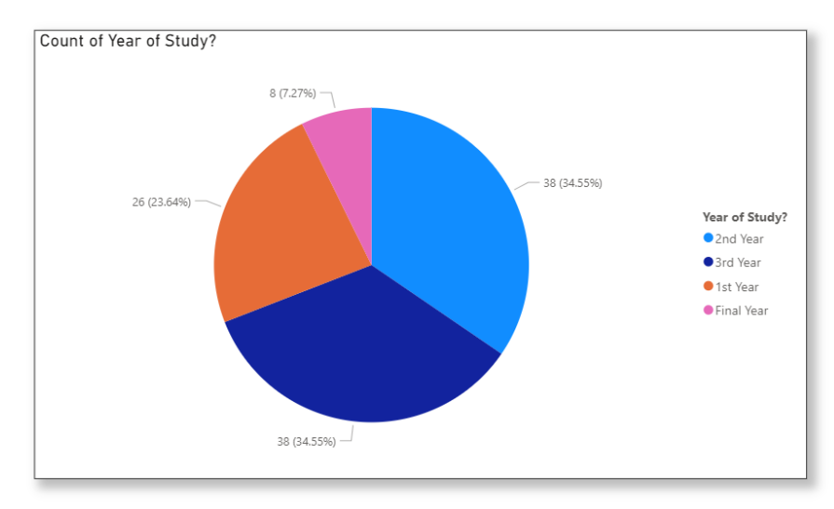
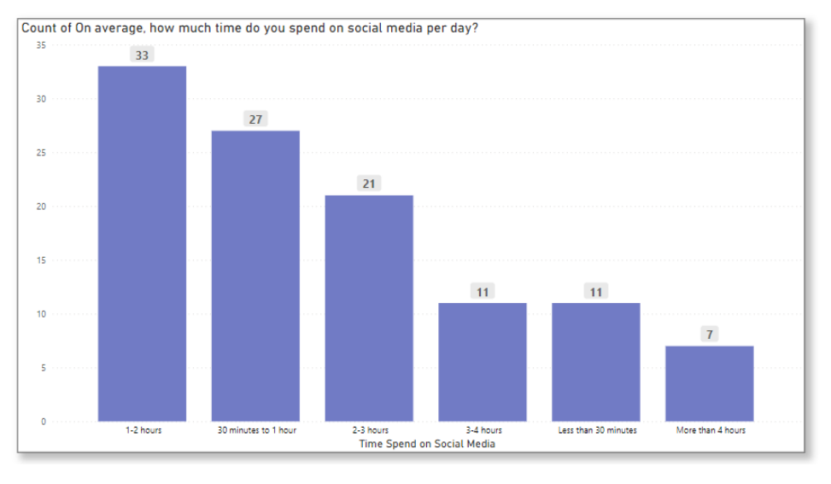

Slide 9
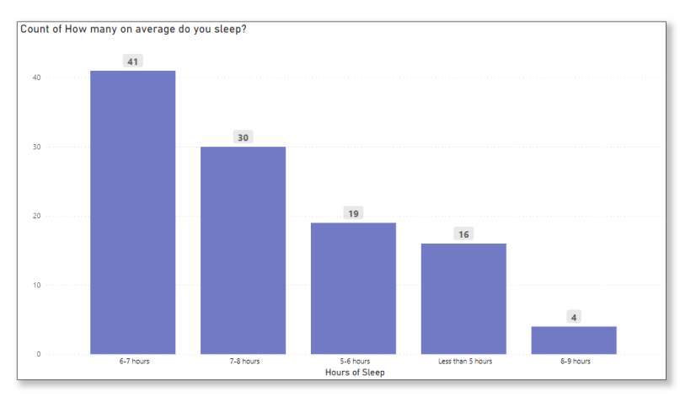
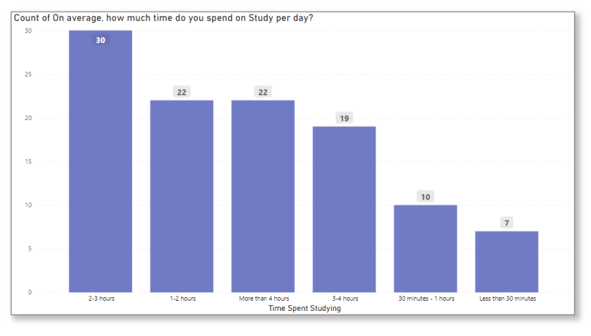

Slide 10
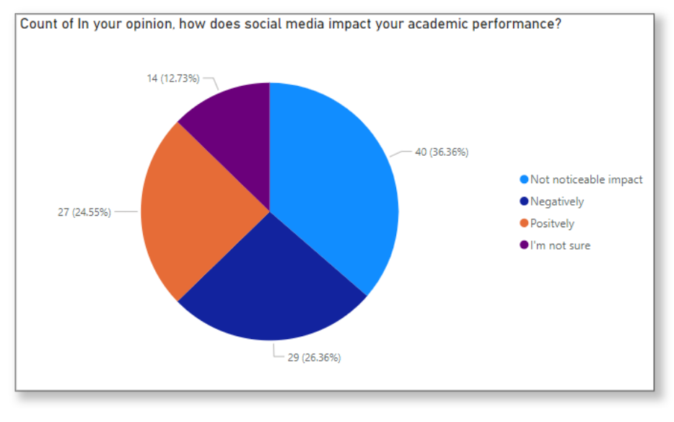
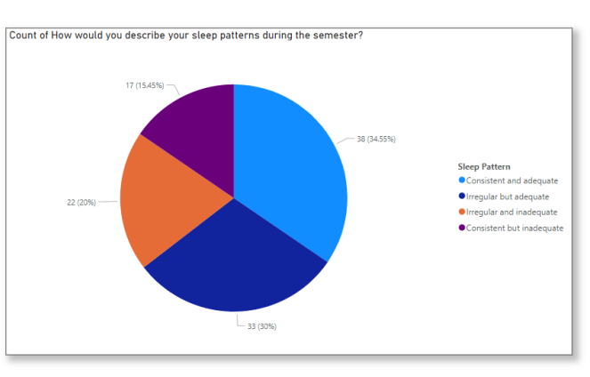

Slide 11
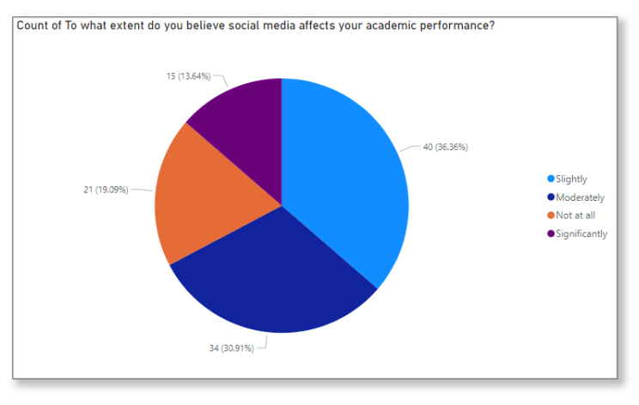
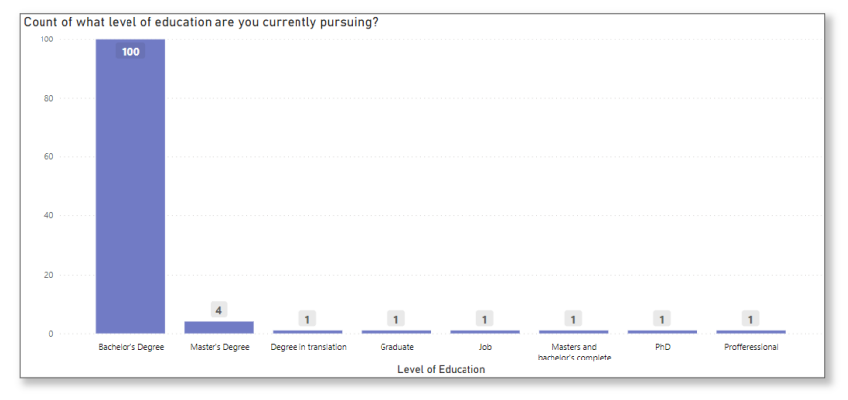

Slide 12
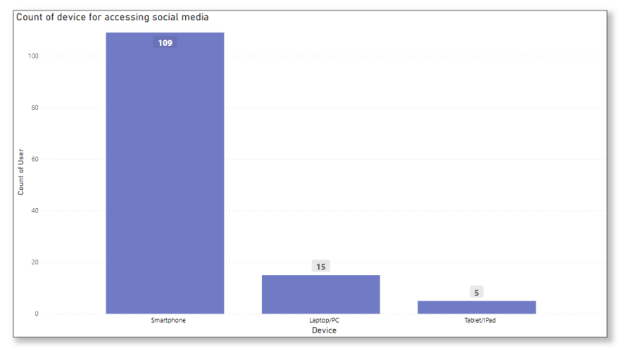
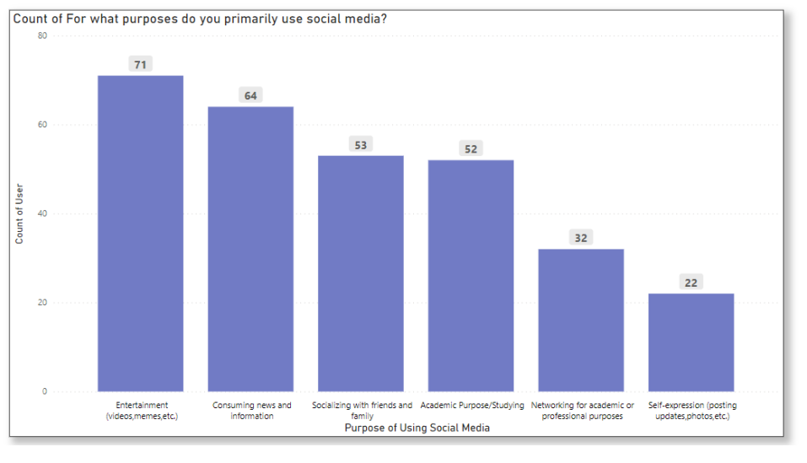

Slide 13
Statistical Analysis
Correlation analysis, also known as bivariate, is primarily concerned with finding out whether a relationship exists between variables and then determining the magnitude and action of that relationship.
The variables under examination include study hours (categorical), social media usage (categorical), and academic performance (numerical). The categorical nature of study and social media hours necessitates the use of non-parametric correlation methods, Given the categorical nature of the variables, Spearman's rank correlation and Kendall's tau are employed.
Correlation Analysis

Slide 14
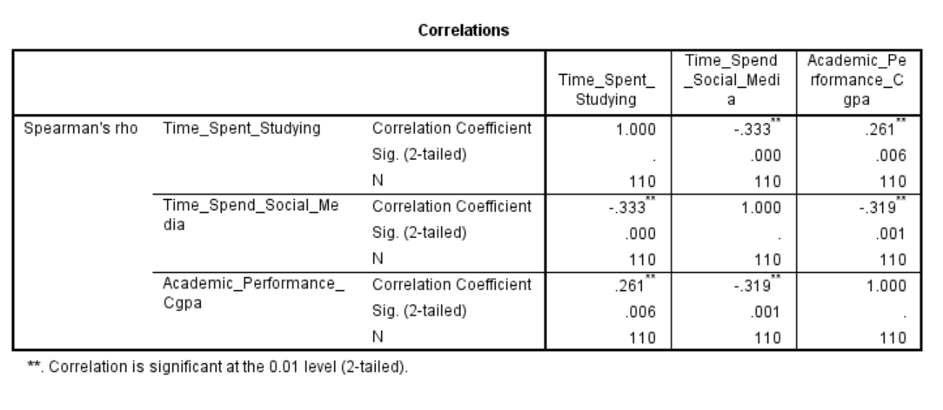
Time Spent Studying vs. Academic Performance
Interpretation: A positive and statistically significant correlation exists between the time spent studying and academic performance (CGPA) at the 0.01 significance level.
Correlation Coefficient: +0.261
Time Spent on Social Media vs. Academic Performance
Interpretation: A negative and statistically significant correlation is observed between time spent on social media and academic performance (CGPA) at the 0.01 significance level.
Correlation Coefficient: -0.319
Time Spent Studying vs. Time Spent on Social Media
Interpretation: A negative and statistically significant correlation is found between the time spent studying and time spent on social media at the 0.01 significance level.
Correlation Coefficient: -0.333

Slide 15
Conclusion:
The results suggest meaningful correlations between times spent studying, time spent
on social media, and academic performance (CGPA) among the study participants. Notably;
Positive Correlation with Studying: There is a positive correlation between time
spent studying and academic performance, indicating that increased study hours are
associated with higher academic achievement.
Negative Correlation with Social Media: Conversely, time spent on social media
shows a negative correlation with academic performance, suggesting that higher social
media usage is associated with lower academic performance.
Negative Correlation between Study and Social Media Time: The negative
correlation between time spent studying and time spent on social media implies a potential
trade-off between these activities.

Slide 16
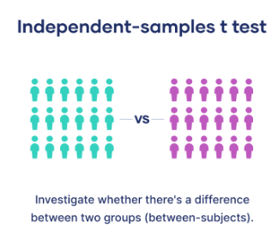
T-Test for Independent Samples: Exploring Gender and Sleep Hours in Relation to CGPA
The T-Test for Independence of Samples is employed to ascertain if there are statistically significant differences in mean CGPA between distinct groups, specifically concerning gender and sleep hours.. An independence sample t-test is used when comparing mean score between two different groups (Gender and Sleep hours) for one continuous variable (Academic Performance).
Assumptions for the T-Test for Independence of Samples:
Independent Observations: The observations in one sample are independent of observations in the other sample.
Normal Distribution:Assumes that the data in each group follows a normal distribution
Homogeneity of Variances:Assumes that the variances of the two groups being compared are approximately equal.

Slide 17
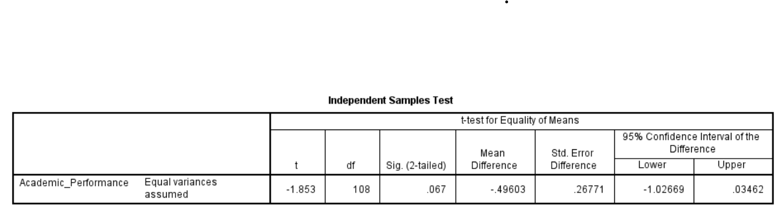
T-Test for Independent Samples: Gender and Academic Performance (CGPA)
Null Hypothesis (H₀): There is no significant difference in mean CGPA between male and female students.
Alternative Hypothesis (H₁): There is a significant difference in mean CGPA between male and female students.
Interpretation
The obtained p-value of 0.067 is greater than the conventional significance level of 0.05. Therefore, we fail to reject the null hypothesis. In practical terms, this implies that there isn't enough evidence to claim a statistically significant difference in mean CGPA between male and female students based on the data.

Slide 18
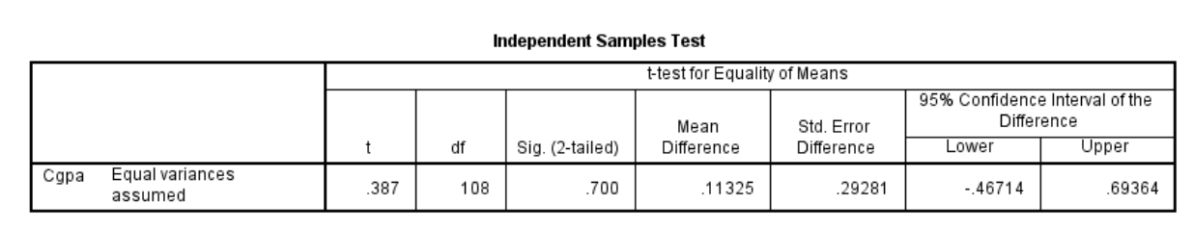
T-Test for Independent Samples: Sleep Hours and Academic Performance (CGPA)
Null Hypothesis (H₀): There is no significant difference in mean CGPA between students who sleep more than 7 hours and those who sleep less than 7 hours.
Alternative Hypothesis (H₁): There is a significant difference in mean CGPA between students who sleep more than 7 hours and those who sleep less than 7 hours.
Interpretation
With a p-value well above the conventional significance level of 0.05, the findings do not provide substantial evidence to reject the null hypothesis. This suggests that there is no significant difference in mean CGPA between students based on their sleep duration. Therefore, the analysis suggests that variations in sleep hours, specifically sleeping more or less than 7 hours, may not be strongly associated with differences in academic performance, as measured by CGPA, in this particular sample.

Slide 19
Conclusion
T-Test for Independent Samples: Gender and Academic Performance (CGPA)
The obtained p-value of 0.067 is greater than the conventional significance level of 0.05.
H0 Accepted
Null Hypothesis (H₀): There is no significant difference in mean CGPA between students who sleep more than 7 hours and those who sleep less than 7 hours
T-Test for Independent Samples: Sleep Hours and Academic Performance (CGPA)
H0 Accepted
p-value 0.700 well above the conventional significance level of 0.05,
Null Hypothesis (H₀): There is no significant difference in mean CGPA between students who sleep more than 7 hours and those who sleep less than 7 hours.

Slide 20
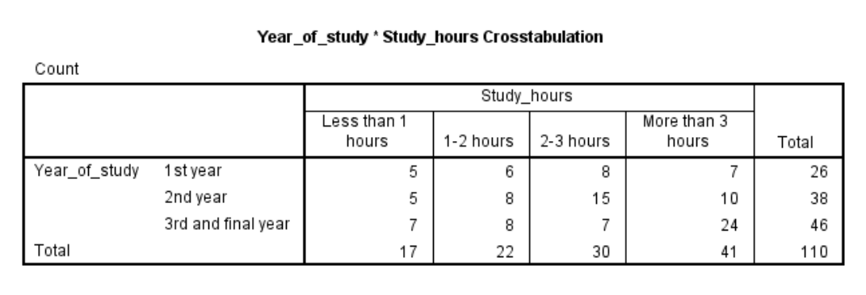
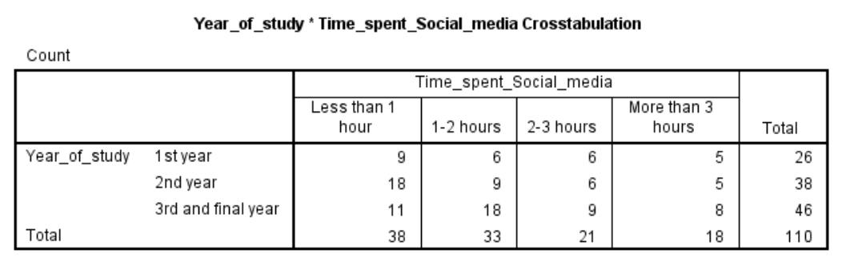
Chi-Square Test: Year of Study vs. Study Hours and Social Media Time Spent:
The Chi-Square Test of Independence is applied to assess the relationship between categorical variables. In this context, we are exploring the association between the year of study (1st year, 2nd year, 3rd, and final year) and two other categorical variables: studyhours and social media time spent.
Cross-tabulation Table for Year of Study and Study Hours
Cross-tabulation Table for Year of Study and Social Media Time Spent

Slide 21
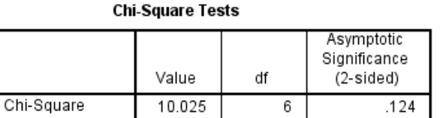
Assumptions for Chi-Square Test:
Independence of Observations: The observation observations in one sample are independent of observations in the other sample.
Categories are Mutually Exclusive: Each participant falls into only one category within each variable.
Sufficient Sample Size: The assumption of a sufficient sample size in the Chi-Square Test ensures that each cell in the contingency table has an expected frequency of at least 5.
Chi-Square Test: Year of Study and Study Hours:
Hypothesis:
Null Hypothesis (H₀): There is no significant association between the year of study and study hours
Alternative Hypothesis (H₁): There is a significant association between the year of study and study hours.
Interpretation and Conclusion: The p-values for all three tests are above the conventional significance level of 0.05. Consequently, there is insufficient evidence to reject the null hypothesis. These results suggest that there is no significant association between the year of study and study hours among the surveyed participants.

Slide 22
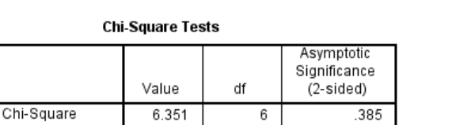
Chi-Square Test: Year of Study and Time Spent on Social Media:
Hypothesis:
Null Hypothesis (H₀): There is no significant association between the year of study and Time spent on social media
Alternative Hypothesis (H₁): There is a significant association between the year of study and Time spent on social media.
Interpretation: Test statistics yield p-values greater than the conventional significance level of 0.05. Therefore, there is insufficient evidence to reject the null hypothesis. These results suggest that, based on the surveyed participants, there is no significant association between the year of study and the amount of time spent on social media.

Slide 23
One Way ANOVA: Sleep Pattern, Year of Study, Study Hours, Social Media Time
Spend and Academic Performance (CGPA):
One-Way Analysis of Variance (ANOVA) is a statistical technique used to assess whether there are significant differences in the means of three or more independent groups. This method is applied to explore variations across various categories and is particularly useful when comparing means across more than two groups.
Assumption:
Independence: Observations within each group must be independent of each other
Normality: The data within each group should be approximately normally distributed. Deviations from normality may become a concern with smaller sample sizes.
Homogeneity of Variances (Homoscedasticity): The variances of the dependent variable should be roughly equal across all groups. Violations of homogeneity of variances can affect the accuracy of the F-test.
Scale of Measurement: The dependent variable should be measured on a continuous scale. This is important for accurately calculating variances and conducting the F-test.

Slide 24
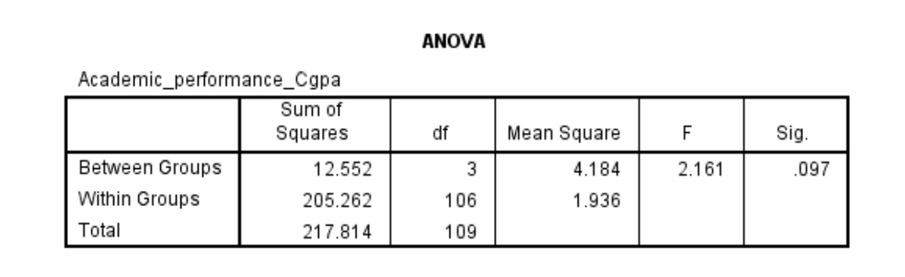
Null Hypothesis (H₀):
(H₀1): There is no significant difference in mean CGPA across different sleep patterns.
(H₀2): There is no significant difference in mean CGPA across various academic years.
(H₀3): There is no significant difference in mean CGPA across different levels of social media time spent.
(H₀4): There is no significant difference in mean CGPA across different study hours.
Alternative Hypothesis (H₁):
(H₁1): There is a significant difference in mean CGPA across different sleep patterns.
(H₁2): There is a significant difference in mean CGPA across various academic years.
(H₁3): There is a significant difference in mean CGPA across different levels of social media time spent. (H₁4): There is a significant difference in mean CGPA across different study hours.
One Way ANOVA: Sleep pattern and CGPA
Interpretation: The p-value (Sig.) associated with the F-Statistic is 0.097, which is greater
than the conventional significance level of 0.05. As a result, there is insufficient evidence to
reject the null hypothesis. This suggests that, based on the sample data, there is no significant
difference in mean CGPA across different sleep patterns.

Slide 25
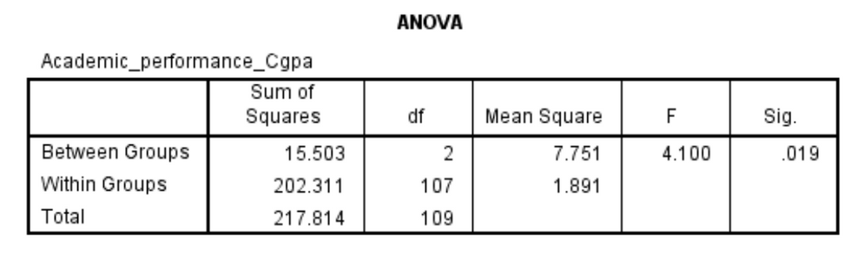
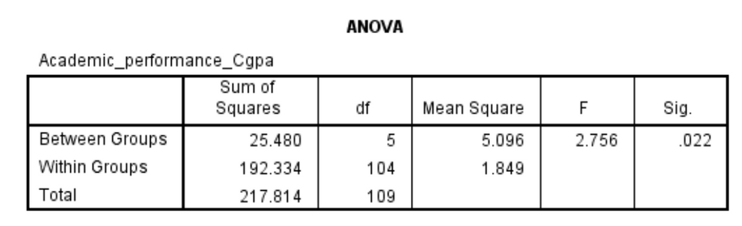
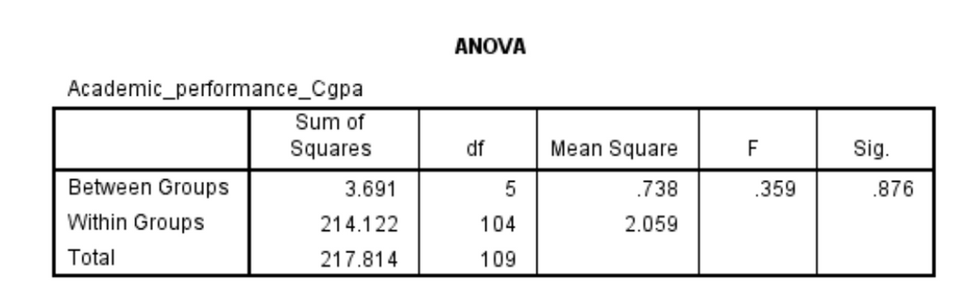
One Way ANOVA: Academic Year and CGPA
Interpretation: The p-value (Sig.) associated with the F-Statistic is 0.019, which is less than the conventional significance level of 0.05. Therefore, there is sufficient evidence to reject the null hypothesis. This suggests that, based on the sample data, there is a significantdifference in mean CGPA across different academic years.
One Way ANOVA: Social Media Time Spend and CGPA
Interpretation: The p-value (Sig.) associated with the F-Statistic is 0.022, which is less
than the conventional significance level of 0.05. Therefore, there is sufficient evidence to
reject the null hypothesis. This suggests that, based on the sample data, there is a significant difference in mean CGPA across different levels of social media time spent. The results indicate that social media time spent may have a significant impact on academic performance, as measured by CGPA.
One Way ANOVA: Study Hours and CGPA
Interpretation: The p-value (Sig.) associated with the F-Statistic is 0.876, which is greater than the conventional significance level of 0.05. Therefore, there is insufficient evidence to reject the null hypothesis. This suggests that, based on the sample data, there is no significantdifference in mean CGPA across different study hours.

Slide 26
One Way ANOVA: Sleep pattern and CGPA
The p-value (Sig.) associated with the F-Statistic is 0.097 > 0.05
Ho Accepted
(H₀1): There is no significant difference in mean CGPA across different sleep patterns.
One Way ANOVA: Academic Year and CGPA
The p-value (Sig.) associated with the F-Statistic is 0.019 < 0.05
Ho Rejected
There is a significant difference in mean CGPA across various academic years.
One Way ANOVA: Social Media Time Spend and CGPA
The p-value (Sig.) associated with the F-Statistic is 0.022 < 0.05
Ho Rejected
There is a significant difference in mean CGPA across various Social Media Time Spend.
One Way ANOVA: Study Hours and CGPA
The p-value (Sig.) associated with the F-Statistic is 0.876 > 0.05
Ho Accepted
(H₀1): There is no significant difference in mean CGPA across different study hours.

Slide 27
Limitations and Conclusion
Limitations that may impact the interpretation of findings:
Reliance on self-reported data may introduce biases such as social desirability and memory recall.
The sample may not fully represent the diverse student population, introducing potential selection bias.
Findings may be context-specific and may not be broadly applicable to diverse educational settings or demographic groups.
"Beyond Likes" reveals key correlations: increased study hours positively link to academic success, while higher social media use negatively associates with performance. Despite limitations, these insights guide educators, policymakers, and students in fostering a balanced academic environment amid evolving technology

Slide 28

Thank you.

